Slide 1


Slide 2


Welcome
We are excited you are here!
Tonight we will cover:
  Graduation requirements
  Assessment requirements
  College admissions requirements
  Dual Enrollment & Online course options
  AICE Diploma Requirements
  Cambridge course options

Slide 3

Stay Informed…..
Join Remind 101:
  To sign up for the Cambridge notifications, please visit https://www.remind.com/join/phsaice or text @phsaice to 81010. You can opt- out of messages at anytime by replying, 'unsubscribe @phsaice'.
  To sign up for the Cambridge notifications, please visit https://https://www.remind.com/join/sjohansen or text @sjohansen to 81010. You can opt- out of messages at anytime by replying, 'unsubscribe @sjohansen'.
  To sign up for the Pasco High School notifications, please visit https://www.remind101.com/join/pascoh or text @pascoh to 81010. You can opt- out of messages at anytime by replying, 'unsubscribe @pascoh'.
Like the PHS Cambridge Facebook Page:
https://www.facebook.com/PascoHighSchoolCambridge
Follow Mrs. Kadlub on Twitter:
@PHS_Principal

Slide 4
FLDOE Standard Diploma Options & Designations
Standard Diploma Options
24 Credit
18 Credit Accel
AICE Cambridge Diploma Curriculum
IB Diploma Curriculum
Diploma Designations
Scholar diploma designation
Merit diploma designation

Slide 5

FLDOE AICE Standard Diploma
Graduation Requirements
24 Credits:
4 English credits
4 Math credits (Algebra 1 and Geometry)
3 Science credits (Biology)
3 Social Studies credits (World, U.S.)
2 World Languages credits
8 additional courses
(Must complete the CIE AICE Curriculum 7 classes)
Minimum 2.0 GPA
Notes:
FLDOE Graduation Requirements Handout
¹Additional Math Notes for 2013/2014:
If enrolled in Algebra 2, must take Algebra 2 EOC and will count for 30% of student’s final course grade once EOC is implemented.
Industry Certifications that lead to college credit may substitute up to 2 math credits but NOT for Algebra 1 or Geometry.
²Science Substitutions for 2013/2014:
Industry Certifications that lead to college credit may substitute up to 1 Science Credit but NOT for Biology 1.
Not all science courses are considered equally rigorous.
³US History Notes:
Students enrolled in Dual Enrollment/AP US History are not required to sit for the State US History End-of-Course Assessment.

Slide 6
FLDOE AICE Exemptions
Cambridge students are exempt from the following standard diploma graduation requirements:
Online Course
Economics with Financial Literacy
U.S. Government
Fine Arts
Health Opportunities through Physical Education (HOPE)
STUDENTS ARE ONLY EXEMPT FROM THESE REQUIREMENTS IF THEY FINISH THE CAMBRIDGE CURRICULUM (7 AICE CLASSES) REQUIRED FOR THE AICE DIPLOMA.
STUDENTS WILL EARN A FLDOE CAMBRIDGE DIPLOMA WITH THE COMPLETION OF THE CAMBRIDGE CURRICULUM.

Slide 7
Assessment Requirements
Students must pass the following statewide assessments:
  Grade 10 ELA (or ACT/SAT concordant score)
  Algebra I end-of-course (EOC)
Students must participate in the EOC assessments and the results constitute 30 percent of the final course grade. These assessments are in the following subjects:
  Biology I
  Geometry
  U.S. History
  Algebra II

Slide 8
Scholar and Merit Designations
Scholar: In addition to standard diploma requirements…
  1 Credit in Algebra 2
  1 Credit in Statistics or an equally rigorous mathematics course
  1 Credit in Chemistry or Physics or an equally rigorous course
  2 credits in the same foreign language
  1 credit of AP, IB, AICE or DE
  Pass EOC’s in Biology, Geometry, Algebra 2 and U.S. History
*A student is exempt from the Biology I or U.S. History assessment if the student is enrolled in an AP, IB or AICE Biology I or U.S. History course and the student
  Takes the respective AP, IB or AICE assessment; and
  Earns the minimum score to earn college credit.
Merit: In addition to standard diploma requirements…
  Attain 1 or more industry certifications

Slide 9
Dual Enrollment & Cambridge?
10th Grade students may start this summer.
Can I earn my AA degree in Cambridge?
How do you register for summer/fall Dual Enrollment courses?
  Summer DE registration end of April
  Fall DE registration 1st week of August
  Must submit PHSC Application
  Must pass PERT exam taken at PHSC
  3.0 Unweighted GPA
  Should currently be enrolled in Alg 2 Hon
*Please check the PHS website for more information.

Slide 10
Online Courses
Reminder: In order for us to approve the class, we need a signed form.
Summer classes need to be approved by the end of this school year.
  If you plan to finish the online course during the summer you may begin at anytime.
2016/2017 Online courses:
Please specify on your course card which online class you would like to take and whether or not you would like a study hall.
If you would like the online class to be part of your 6 period day in the Fall of 2016 you must wait until July 1st to begin.

Slide 11
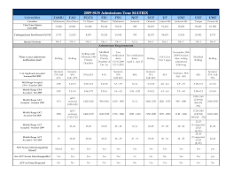
State University Admissions
Minimum Admission Requirements
16 Credits of college preparatory academic courses
4 Math credits Algebra 1 and above
2 Foreign Language courses
What counts? Every college is different:
Academically rigorous courses
GPA
SAT or ACT scores
Extra Curricular Activities
Letters of Recommendation
Admissions Essay
Notes:
SUS Admissions Matrix

Slide 12
SAT and ACT
What are they and why do they matter?
Do I need to prepare or study for these?
When do I take the PSAT?
When do I take the SAT and ACT?
What resources are available?

Slide 13
Important Notes for Upcoming Seniors
Finish Junior year strong these are the last semester grades on your college application!
We will be hosting a senior parent night in the fall.
You should be registered to take the SAT and ACT before the end of the school year.
It is important to check the application window status for the Universities you are interested in.
To do this summer:
  Study for SAT/ACT retake
  Tour and research Universities
  Work on senior resume
  Finish community service

Slide 14
Community Service for Bright Futures
Should be altruistic in nature.
Serve the community directly or any non-profit organization.
Should be varied (it is recommended, not required, to have a maximum of 25 hours from the same organization).
Church service must benefit the community directly, not solely the church.
If you are unsure if it will count, please email Mrs. Johansen or submit a Pre-Approval for.
  Where do I get a Pre-Approval form and hours log form?
    Back guidance desk
    PHS Website- Cambridge page
  Please keep a hard copy of all completed forms and turn the original in to Mrs. Johansen (These are entered quarterly).

Slide 15
Bright Futures Scholarship
Under the AICE Diploma there are 2 options for earning
Bright Futures:
Option 1: Students who earn the CIE AICE diploma and complete 100 hours of community service will be awarded the Florida Academic Scholars scholarship.
*These students are exempt from meeting the GPA and SAT/ACT Requirements.
Option 2: For students that do not earn the CIE AICE Diploma but complete the AICE Curriculum:
Florida Academic Scholars:
1290 SAT or 29 ACT
100 hours Community Service
Florida Medallion Scholars:
1170 SAT or 26 ACT
75 Hours of Community Service
*Students who meet these requirements are exempt from meeting the GPA requirement.
*Please check the PHS website for more information.

Slide 16
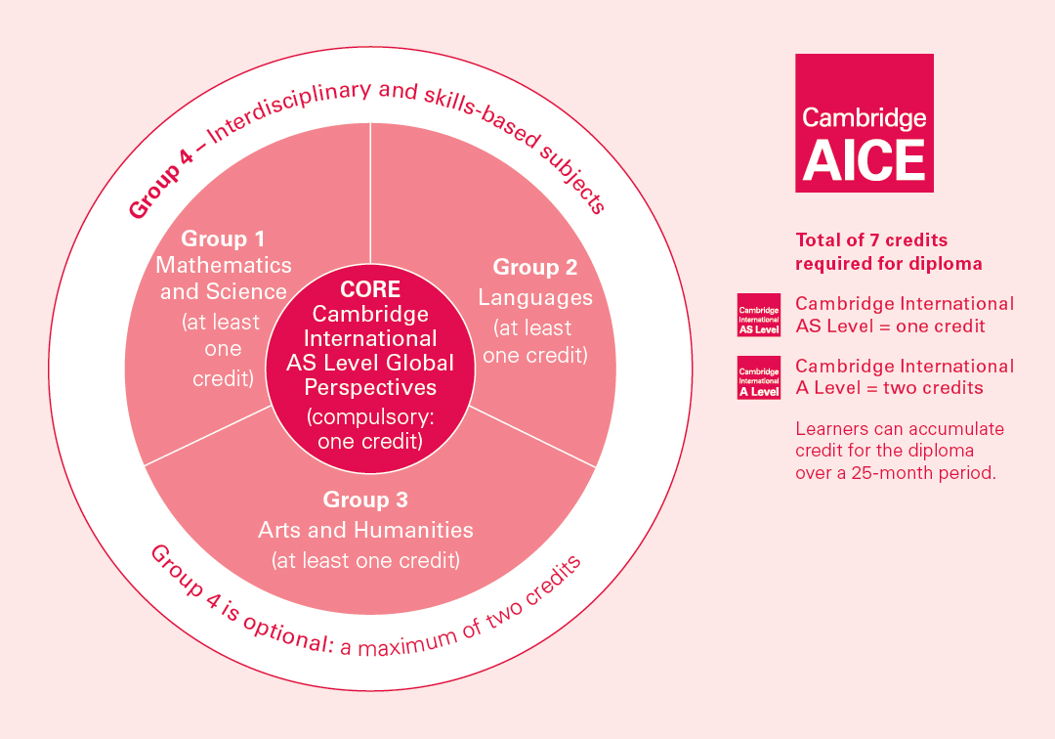

Slide 17
10th Grade Academic Courses
Subject | Course Title
English | Pre-AICE English Literature
Social Studies | AS U.S. History or Honors U.S. History
Science | Pre-AICE Chemistry
Math | Honors Geometry/Pre-AICE Math 2 (if you took Algebra 1 in 9th Grade) or Honors Algebra 2/Pre-AICE Math 3 (if you took Honors Geometry in 9th grade) or AICE Mathematics-Probability & Statistics (if you took Honors Algebra 2 in 9th Grade) or Pre-Calculus (if you took Honors Algebra 2 in 9th Grade)

Slide 18
11th Grade Academic Courses
Subject | Course Title
English | AICE English Language
Social Studies Elective | AICE Global Perspectives
Science | AICE Biology or AICE Chemistry or AICE Environmental Management
Math | Circle one: Honors Algebra 2/Pre-AICE Math 3 (if you took Honors Geometry in 10th grade) or AICE Mathematics-Probability & Statistics (if you took Honors Algebra 2 in 10th Grade) or Pre-Calculus (if you took Honors Algebra 2 in 10th Grade) or AP Calculus (if you took Pre-Calculus in 10th Grade)

Slide 19
12th Grade Academic Courses
Subject | Course Title
English | AICE English Literature
Social Studies | Only 3 credits required – if already met may choose elective or elect to take another social studies course.
Science | Only three credits required- if already met may choose an elective or elect to take another science course.
Math | Circle one: AICE Mathematics-Probability & Statistics (if you took Honors Algebra 2 in 11th Grade) or Pre-Calculus (if you took Honors Algebra 2 in 11th Grade) or AP Calculus (if you took Pre-Calculus in 11th Grade)

Slide 20
Cambridge Elective Options
Pre-AICE Level Electives
Pre-AICE Design and Technology
Pre-AICE French 1
Pre-AICE French 2
Pre-AICE Spanish 1
Pre-AICE Spanish 2
Pre-AICE Spanish 3
AICE Level Electives
AICE Art & Design
AICE Biology
AICE Business Studies
AICE Chemistry
AICE Design and Technology
AICE Environmental Management
AICE Geography
AICE Global Perspectives
AICE Mathematics-Probability & Statistics
AICE Psychology
AICE Spanish Language
AICE Thinking Skills
AICE U.S. History

Slide 21
Registration Timeline
February 1st- Pirate Curriculum Night 6 p.m.
February 1st-4th- Elective & academy teachers will have tables setup during lunches.
February 4th- Financial Aid Night 6 p.m. IRC (Upcoming Seniors)
February 5th- Students will be given their course cards to fill out and turn in during the activity period.
Please reference the PHS website under the Cambridge tab for more information.

Slide 22
Program Highlights
  We currently have 308 students in the Cambridge Programme.
  We will be administering 377 AICE examinations in 2016.
  We have over 200 applicants for the incoming 9th grade class.
  Our Cambridge Ambassadors Club is involved in various service projects and fundraisers.
  Our Thinking Skills pass rate was 76% in the first year. The three seniors who took the class and passed the test were easily able to transfer their credits into Ave Maria University, FSU and University of Alabama.
  Our teachers have been consistently continuing their Cambridge professional development.

Slide 23
We thank you for being a part of our Cambridge Family!

