Slide 1
How to Do the Dual Enrollment Online Request Process
Pasco High School 2019-2020

Slide 2
First…
Did you apply to PHSC as a dual enrollment student?
https://cpnta.phsc.edu/dualapp/english/WDEAI.aspx
Did you receive an email in response to your application?
Did you turn in the planning sheet to your school counselor?
Did you speak with your school counselor about your eligibility as a dual enrollment student?
If not, then you need to do those things ASAP or it may delay the process of registration.

Slide 3
Next…
Students: you will fill out the online request form complete with the classes you put on that planning sheet
https://admissions.phsc.edu/start/high-school/dual-enroll/charter-public
Click on the third link on the right

Slide 4
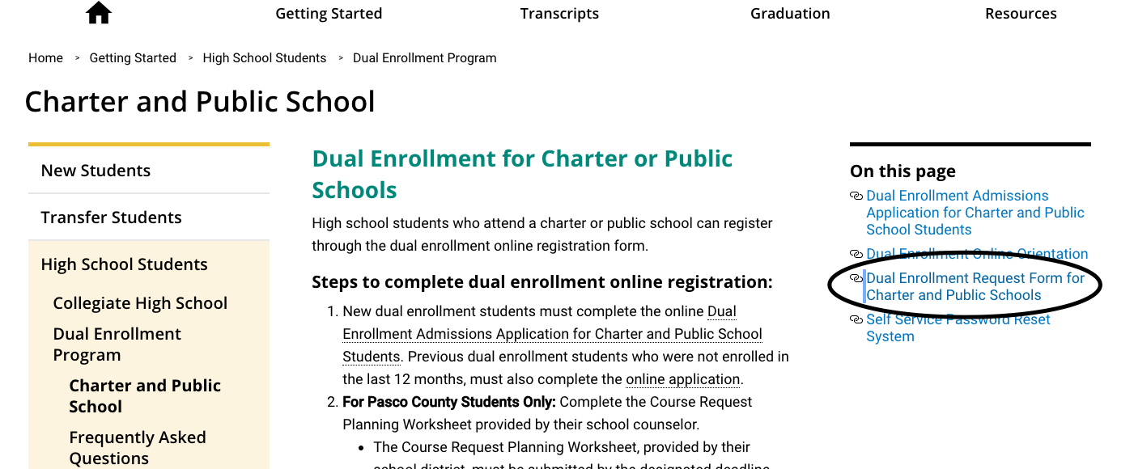

Slide 5
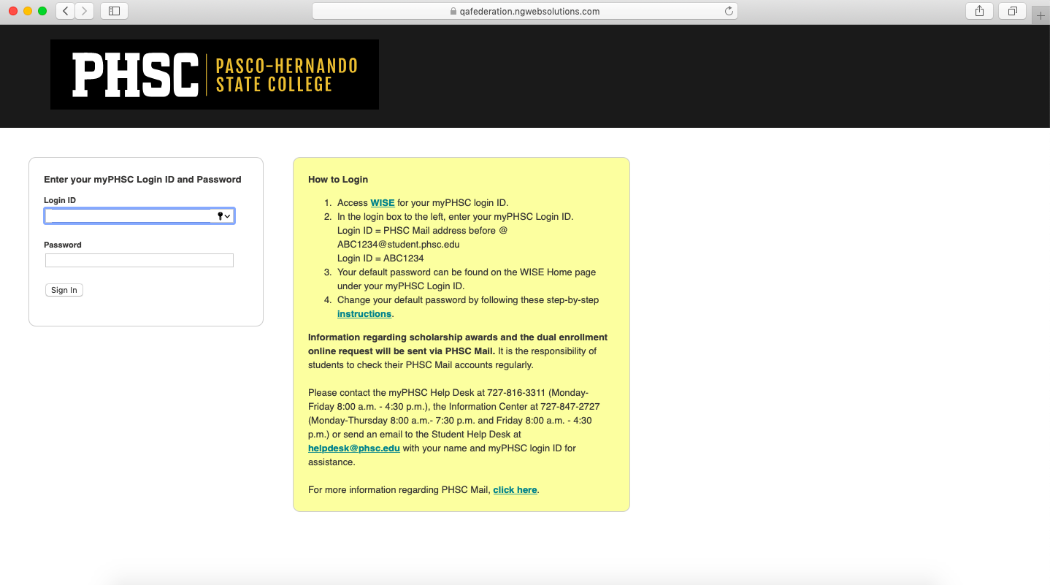

Slide 6
Once you are on the form…
Make sure you put a parent email that is accessible
When you enter your classes, make sure you enter as many as possible to increase your chances of getting a class
If you want to do online classes, you have to do the online readiness module ASAP after doing this process
If you do not care if you take a course online or on campus, choose “PHSC on campus or online” to increase the number of sections available to you when it is time for registration
If you are signing up for Micro Apps or Intro to Public Speaking, please put “On High School Campus”
MAKE SURE YOU HIT NEXT ALL THE WAY TO THE END (the signature page)

Slide 7
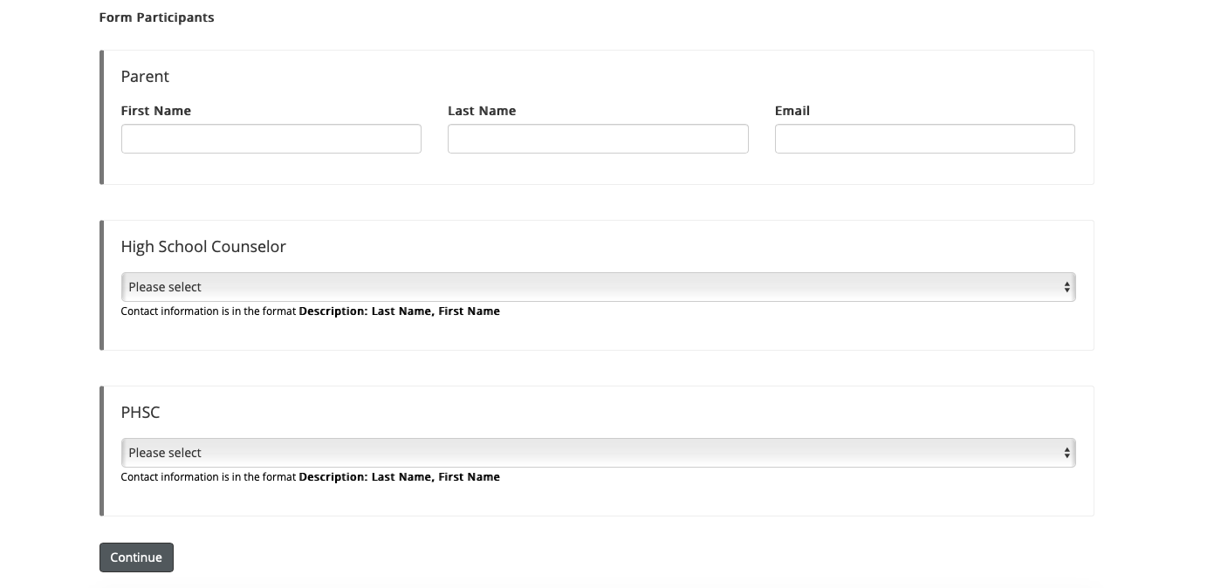
This is where it needs to be the same parent email that is linked to the parent account
These both will Pasco High School

Slide 8
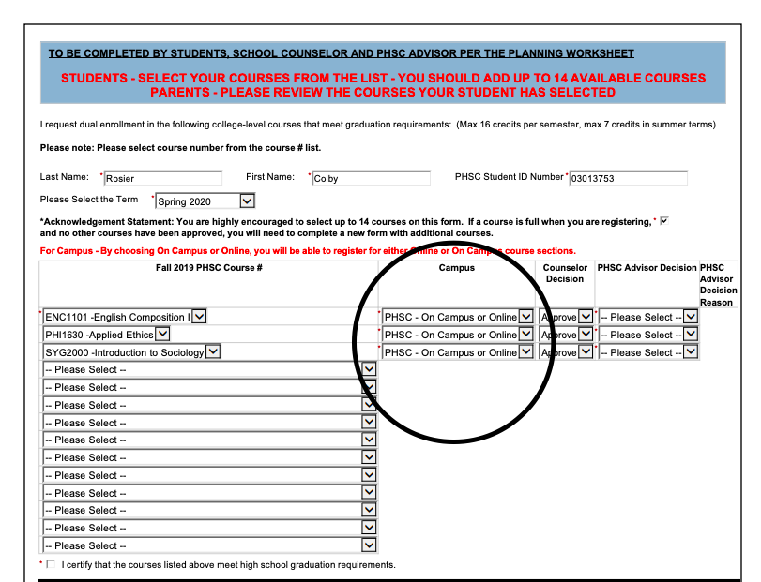

Slide 9
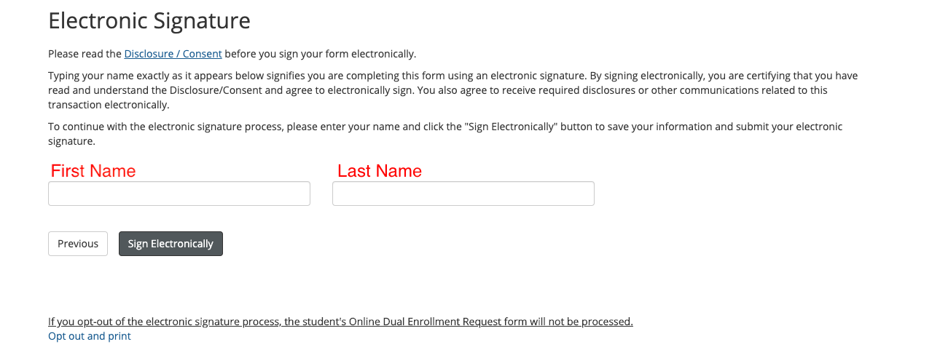

Slide 10
The Parent Form
Your parent will need to make an account using that specific email address in order to receive the form that they have to fill out
Once your parent receives the email, they will need to sign in with the account they made and fill out the form
MAKE SURE YOU HIT NEXT ALL THE WAY TO THE END (the signature page)

Slide 12
Next…
If the parent form goes through correctly, the school counselors should receive an email automatically to fill out their part
If you did not speak to your counselor before filling out this form, make sure you do so ASAP so that there is no reason that the form will be rejected on our end
Once the counselor approves, the form will be sent to PHSC for the advisor there to approve
The student will receive an email if the form was rejected by PHSC
If you are rejected, please speak with your school counselor about why that might have happened
Notes:
Once PHSC has it, it may take up to three days to get approved

Slide 13
If you do not receive a rejection email…
Then you are good to go!
This Photo by Unknown Author is licensed under CC BY-SA-NC

Slide 14
Web Registration Dates and Times
Next step is registration:
Seniors register on November 19th
Juniors register on November 20th
Sophomores register on November 21st
Freshman register on November 22nd
If you have more than 45 credits and want to register before your date, you have to make an appointment at PHSC beginning Oct. 29th
You can begin web registration at:
8 am if you have 30+ credits
9 am if you have 15+ credits
10 am if you have 1+ credits
11 am if you are a first time dual enrollment student

Slide 15
Any Questions?

